Slide 1


CV TEXT MINING
Bhrigu MAHAJAN
M.E (SDM) -2017

Slide 2
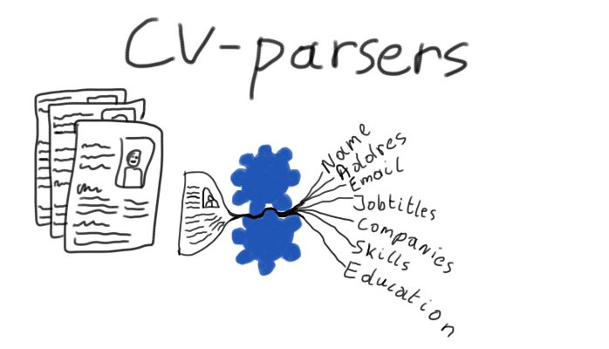
PROJECT INTRODUCTION
Upload CV
Extracting or mining essential information
Patterns Identification
Categorization of Texts

Slide 3

PROBLEM STATEMENT
Huge volume of CVs
Manually identify the CV
Different format and style
Identify the criteria

Slide 4
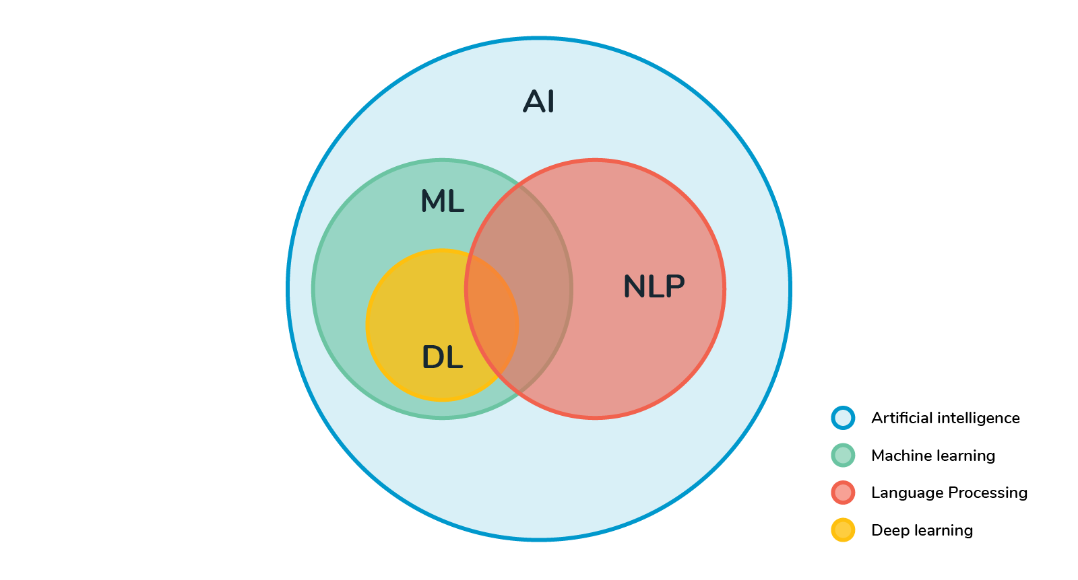
PURPOSED METHOD
Google Phone Library API to identify the numbers
Regex Patterns to identify the email patterns and date of birth
ParallelDots NLP to identify name entities
TextRazor NLP to identify university and organizations

Slide 5
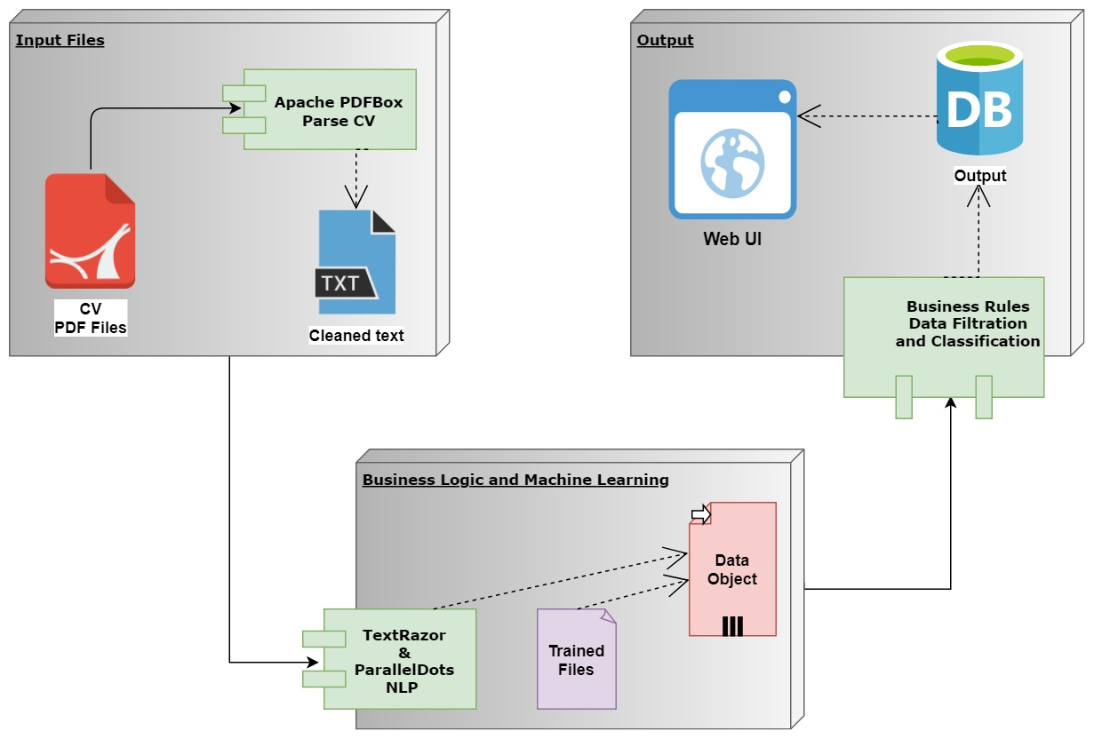
3 STEP ARCHITECTURE
Raw Text
Information Extraction
Text Categorization
Concept Linkage
Text Clustering
Association Rule
Business Rules

Slide 6
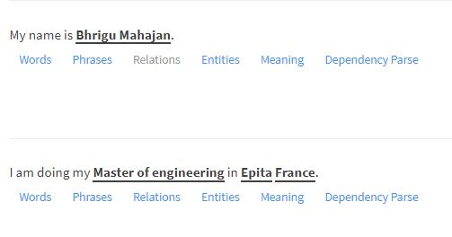
INFORMATION EXTRACTION

Slide 7
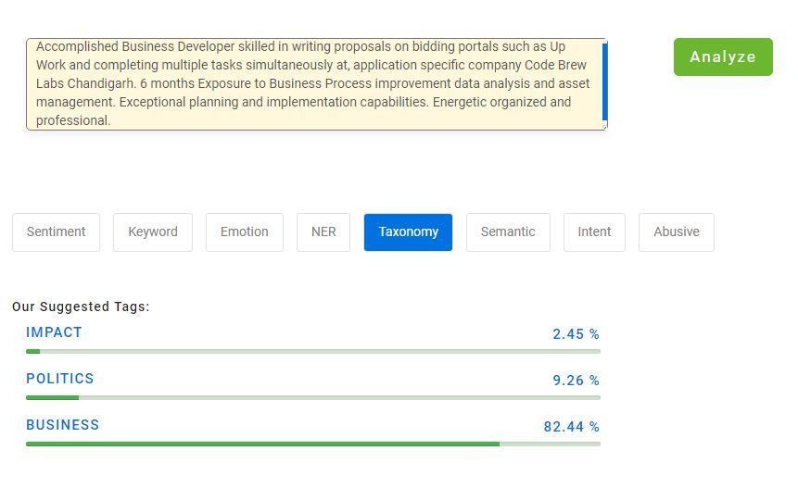
TEXT CATEGORIZATION

Slide 8
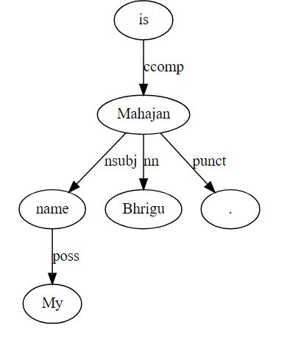
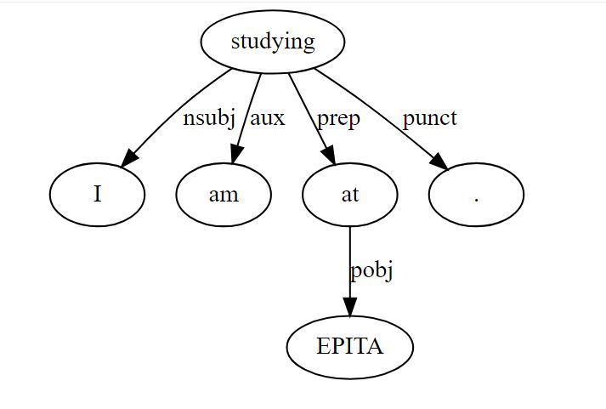
CONCEPT LINKAGE

Slide 9
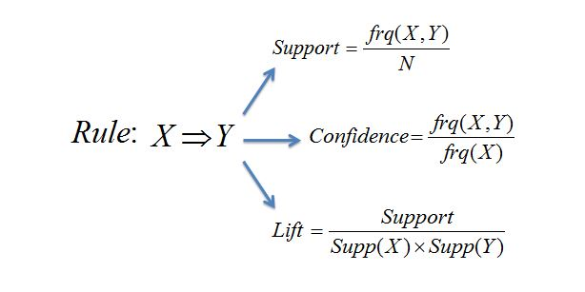
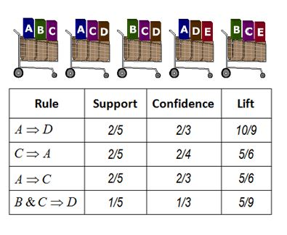
ASSOCIATION RULE

Slide 10
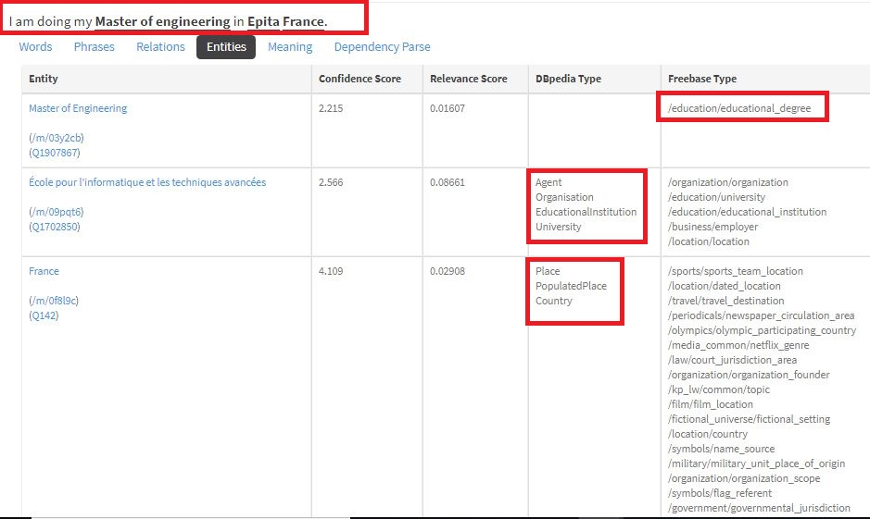
TEXT CLUSTERING

Slide 11
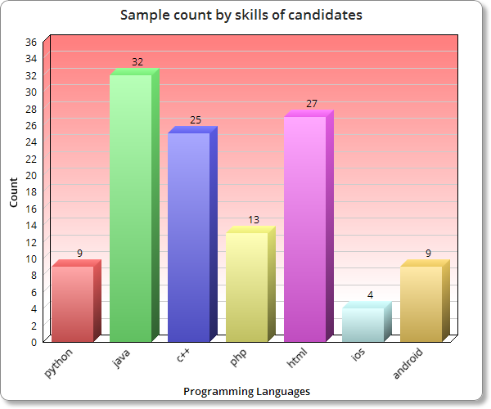
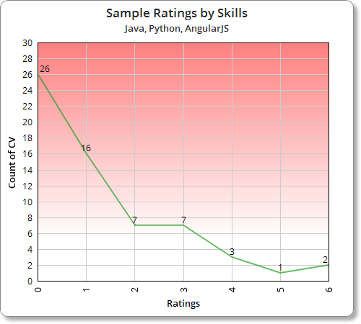
SAMPLE RESULTS

Slide 12
CONCLUSION NEXT STEPS
Accuracy for standard format
Accuracy enhanced by trained data set.
Rating on the combination of skills, university, experience, job profile
Online aptitude test on the skills extracted
Scope enhanced to file formats like RTF and JPEG

Slide 13


